Slide 1
SWITCHES AND RELAYS
Switch – is an electronic component or device that can interrupt the electrical current in one or more circuits.
Also known as make or break device.

Slide 2
Basic Switch Function
To open and close a circuit
Acts as control devices
Does not consume power

Slide 3
Switch Action
Momentary action – are used to make momentary contact (for a brief period of time or as long the button is pressed).
Latched action – maintain the contact until it is forced to the other position.

Slide 4
Types of Switches
Mechanical Switches – are physical switches, which must be activated physically, by moving, pressing, releasing, or touching its contacts.
Electronic Switches – do not require any physical contact in order to control a circuit. These are activated by semiconductor action.

Slide 5
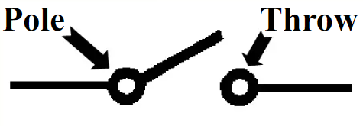
POLE – what the switch armature is connected into.
THROW – the closed position of the switch

Slide 6
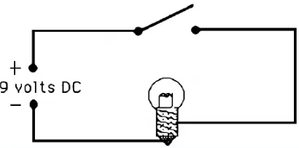
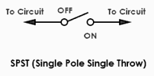
SINGLE POLE SINGLE THROW (SPST)
One pole, one throw.

Slide 7
SINGLE POLE SINGLE THROW (SPST)
This is the basic ON and OFF switch consisting of one input contact and one output contact.
It switches a single circuit and it can either make (ON) or break (OFF) the load.

Slide 8
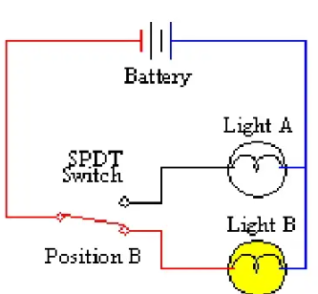
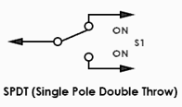
SINGLE POLE DOUBLE THROW (SPDT)
One pole, two throws.

Slide 9
SINGLE POLE DOUBLE THROW (SPDT)
This switch has three terminals: one is input contact and remaining two are output contacts.
It consist of two ON positions and one OFF position.

Slide 10
SINGLE POLE DOUBLE THROW (SPDT)
These switches are used as changeover to connect the input between two choices of outputs.
The contact which is connected to the input by default is referred as normally closed contact and contact which will be connected during ON operation is a normally open contact.

Slide 11
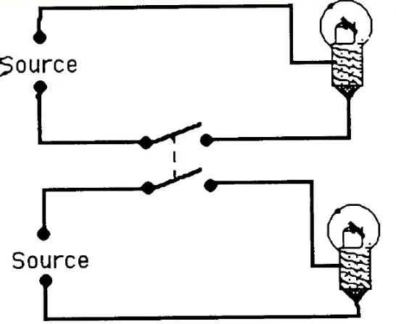

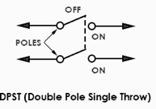
DOUBLE POLE SINGLE THROW (DPST)
Two poles, one throw. Contact is made at the same time.

Slide 12
DOUBLE POLE SINGLE THROW (DPST)
This switch consists of four terminals: two input contacts and two output contacts.
It behaves like a two separate SPST configurations, operating at the same time.
It has only one ON position, but it can actuate the two contacts simultaneously,

Slide 13
DOUBLE POLE SINGLE THROW (DPST)
such that each input contact will be connected to its corresponding output contact.
In OFF position both switches are at open state.
This type of switches is used for controlling two different circuits at a time.

Slide 14
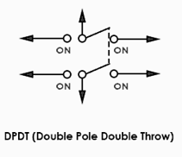
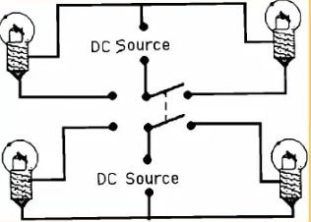
DOUBLE POLE DOUBLE THROW (DPDT)
Two poles, two throws.
2 separate closed position.

Slide 15
DOUBLE POLE DOUBLE THROW (DPDT)
This is a dual ON/OFF switch consisting of two ON positions.
It has six terminals, two are input contacts and remaining four are the output contacts.
It behaves like a two separate SPDT configuration, operating at the same time.

Slide 16
DOUBLE POLE DOUBLE THROW (DPDT)
Two input contacts are connected to the one set of output contacts in one position and in another position, input contacts are connected to the other set of output contacts.

Slide 17
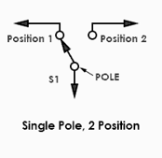
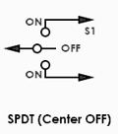
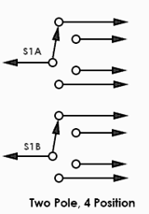
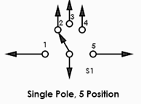
OTHER TYPE OF SWITCHES

Slide 18
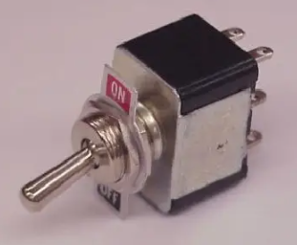
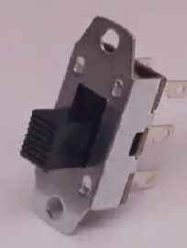
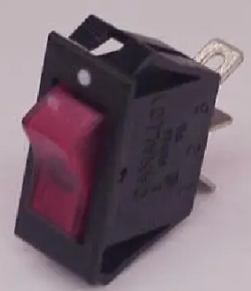


SWITCH STYLES
TOGGLE SLIDE ROCKER

Slide 19
TOGGLE SWITCH
A toggle switch is manually actuated (or pushed up or down) by a mechanical handle, lever or rocking mechanism. These are commonly used as light control switches.

Slide 20
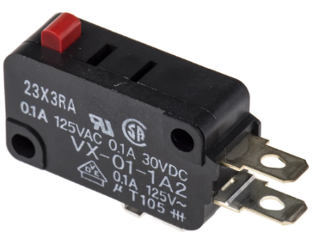
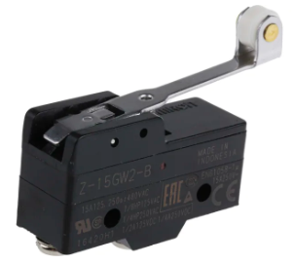
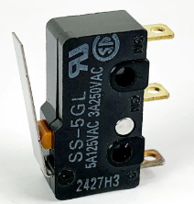


SWITCH STYLES
MICRO SWITCH LIMIT SWITCH

Slide 21
LIMIT SWITCH
Limit switches are operated by the presence of an object or by the absence of objects or by the motion of machine instead of human hand operation.
These switches consist of a bumper type of arm actuated by an object. When this bumper arm is actuated, it causes the switch contacts to change position.

Slide 22
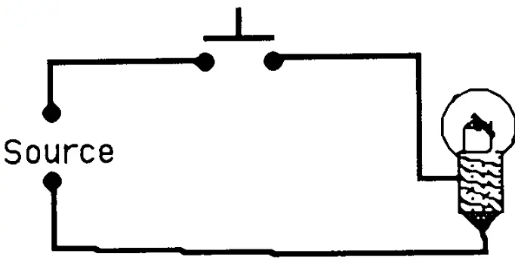
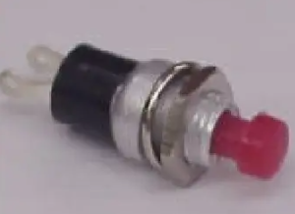
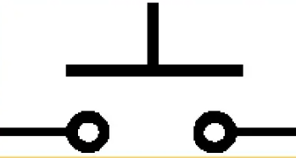
SWITCH STYLES
PUSH BUTTON NORMALLY OPEN
PBNO (red in color)
Momentary contact

Slide 23
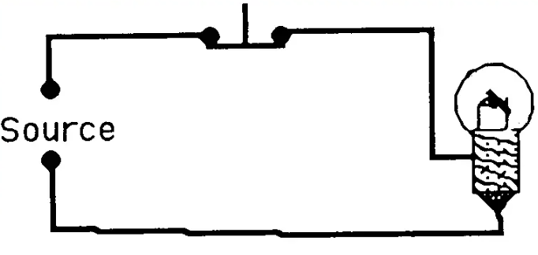
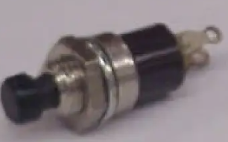
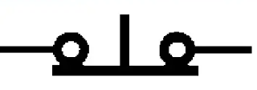
SWITCH STYLES
PUSH BUTTON NORMALLY CLOSED
PBNC (black in color)
Momentary contact

Slide 24
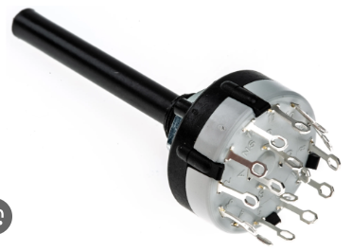
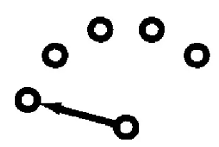
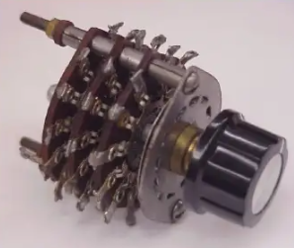
ROTARY SWITCHES
Used for complex circuits

Slide 25
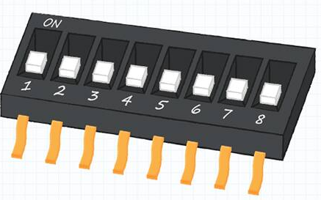
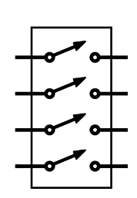
DIP SWITCHES
The DIP switch is made up of a set of switches in a single unit, usually mounted on a PCB or breadboard. The switch’s very basic operation, in which the switch’s position must be set manually.

Slide 26
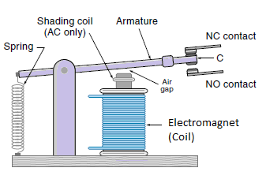
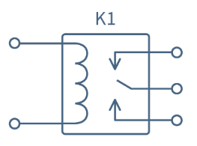
RELAYS
Electromechanical relay (EMR) is a device that uses an electromagnet to provide the force to close or open switch contacts, hence, it is an electrically powered switch.

Slide 27
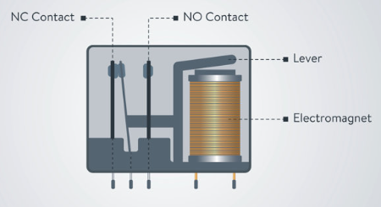
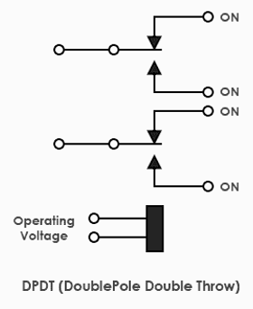
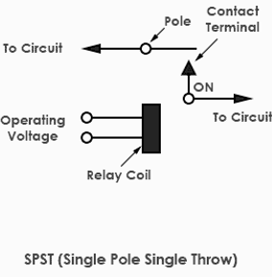
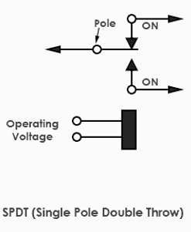
RELAYS

Slide 28
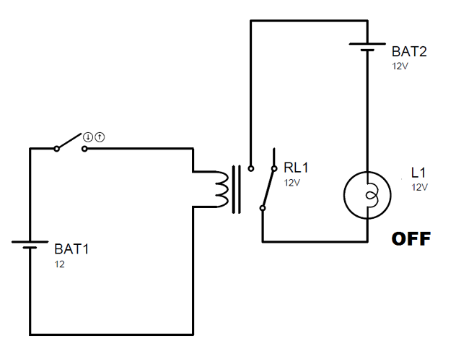
RELAYS
Switch is NO
Coil is not energized
Bulb is off
Relay is open

Slide 29
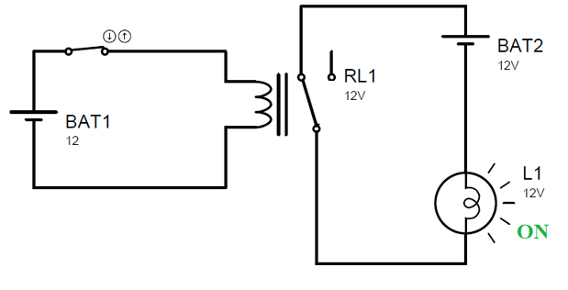
RELAYS
Switch is NC
Coil is energized
Bulb is on
Relay is closed

Slide 30
